Slide 1

Lab 3: Clustering and PCA
MGT 665 - Machine Learning Applications
Andrey Castel

Slide 2
Synthetic Healthcare Data: Clustering
Exploring patterns using K-Means, Hierarchical Clustering, and PCA.
Notes:
Welcome to our Lab 3 presentation. We'll look at how we used clustering and PCA to find wellness patterns in a sample dataset.

Slide 3
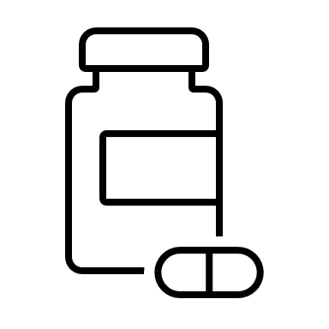



Why This Matters
Machine learning can help health organizations find patterns in behavior to offer better wellness advice.
Notes:
Understanding behavior patterns helps health professionals offer personalized plans. We used clustering to group similar people.

Slide 4

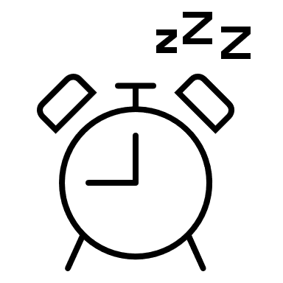


What We Did
We created a simulated dataset of 300 people with details like exercise, meals, sleep, stress, and BMI.
Notes:
We used five features to simulate wellness habits. This allowed us to test clustering and PCA techniques.

Slide 5
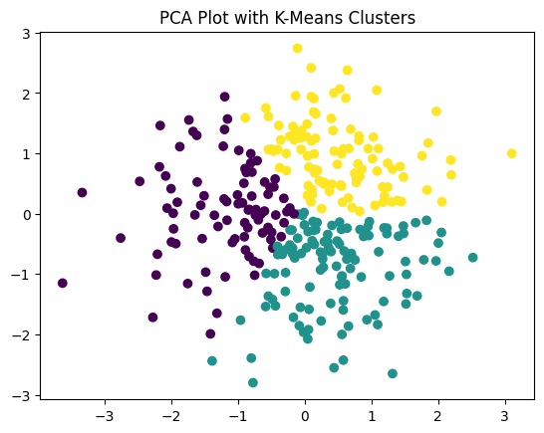
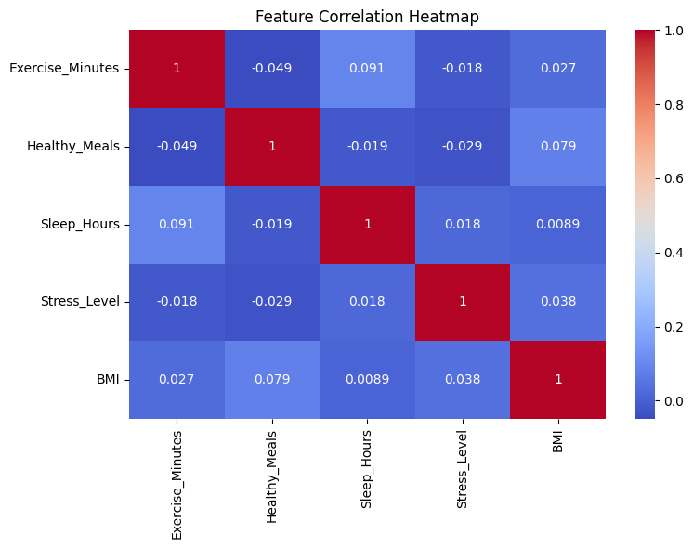
Data Exploration
We looked at the data using scatter plots and heatmaps to understand the relationships.
Notes:
We first explored the data visually to see h ow the features related to one another before applying machine learning. No features are strongly correlated, so each feature is likely contributing unique information to the clustering model.
It's safe to keep all features for analysis—none are redundant.
In real data, you might expect stronger patterns (e.g., high stress leading to less sleep), but in this synthetic dataset, relationships are subtle.

Slide 6
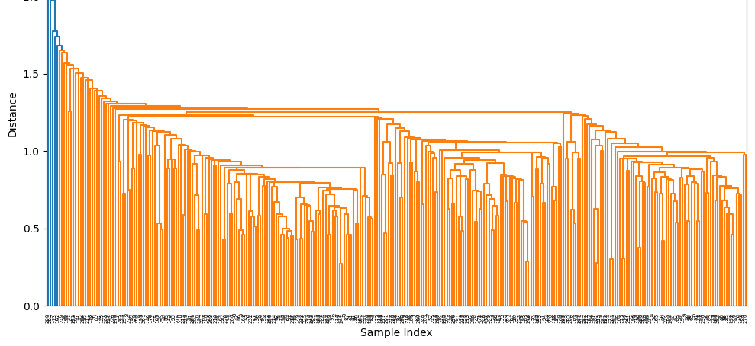
Hierarchical Clustering
The dendrogram showed an extremely large amount of natural clusters using single linkage.
Notes:
Hierarchical clustering using single linkage was not helpful to discern between groups. This did not help us understand how the data separated.

Slide 7
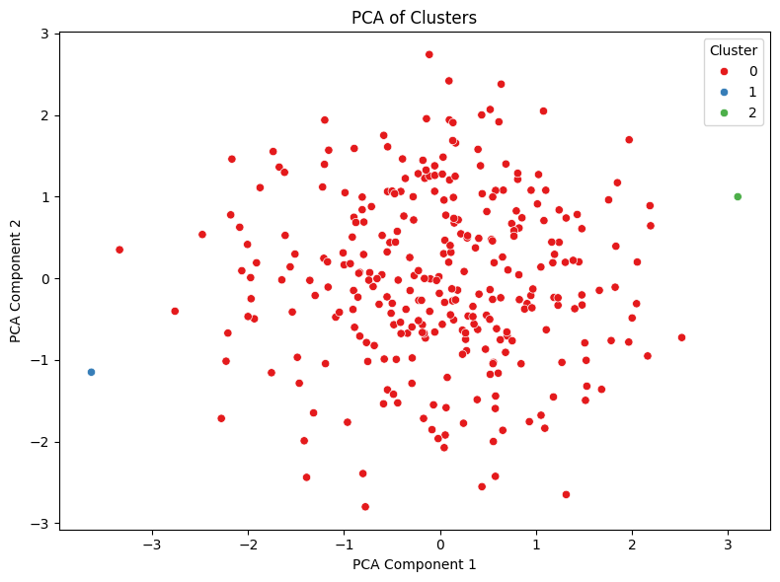

PCA – Dimensionality Reduction
PCA reduced data to two main components explaining 44% variance.
Notes:
PCA helped simplify the data. The 2 components captured most of the variation and made the data easier to visualize.

Slide 8
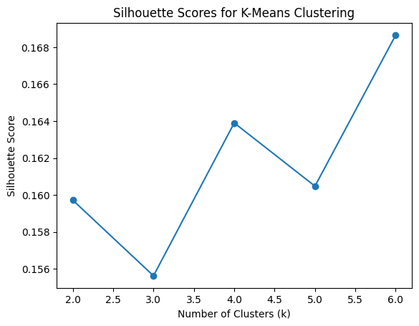
K-Means Clustering
Best performance at k=3 to 5. Minimal increase to Silhouette score. Overall increase in silhouette score to 0.34 after PCA.
Notes:
K-Means also found 3 clusters. When we used PCA, it performed a little better than before.

Slide 9
Key Takeaways
Clustering + PCA gave better performance and clearer insights. 3 distinct wellness groups were found.
Notes:
Combining these techniques gave us better results. We found clear patterns that could guide wellness programs.

Slide 10

Next Steps
Use real health data to create targeted wellness plans based on similar behavior groups.
Create a more in-depth method to determine correlation between the features
Notes:
This study used fake data. Next, we should apply it to real data to help build wellness plans for people.

